Slide 1





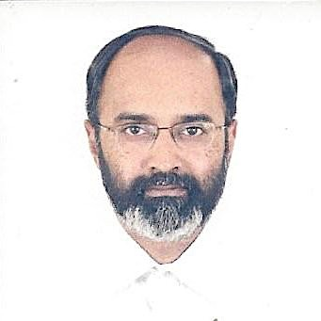
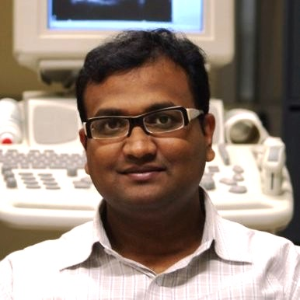
Jointly Learning Convolutional Representations to Compress Radiological Images and Classify Thoracic Diseases in the Compressed Domain
Paper ID
55
Ekagra
Ranjan
Soumava Paul
Siddharth Kapoor
Aupendu Kar
Ramanathan Sethuraman
Debdoot Sheet

Slide 2
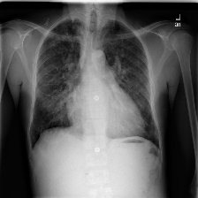
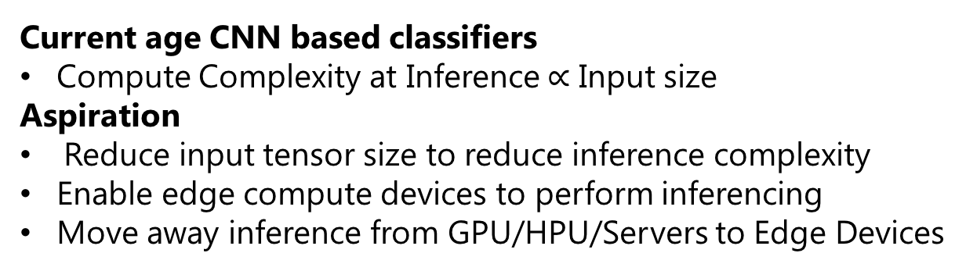
Preamble
Compressor
Decompressor
Archive
Current age CNN based classifiers
Compute Complexity at Inference$∝$ Input size
Aspiration
Reduce input tensor size to reduce inference complexity
Enable edge compute devices to perform inferencing
Move away inference from GPU/HPU/Servers to Edge Devices
Compressed Domain Classifier
Classifier
Disease Prediction

Slide 3
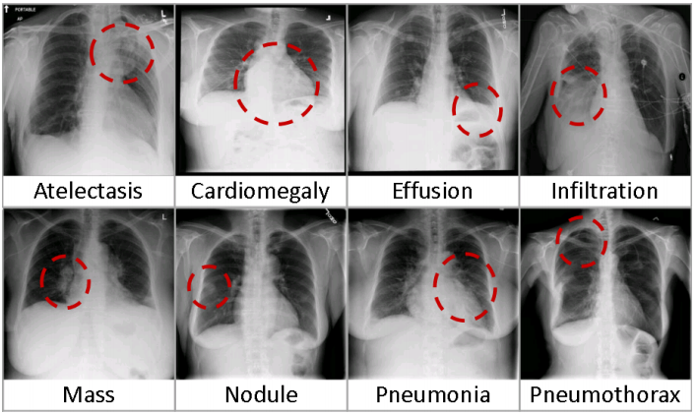
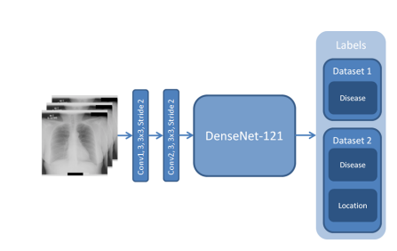
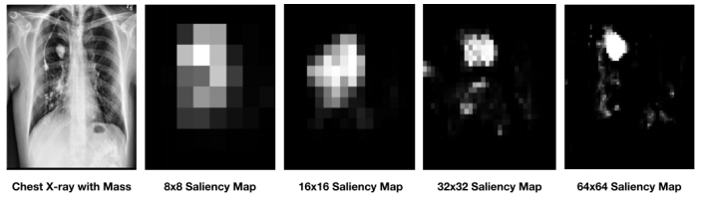
Prior Art
ChestX-ray8, Xiaosong Wang, et. al., CVPR 2017.
  1st work – Updating ImageNet pretrained DNN models in Model Zoos
Weakly Supervised Medical Diagnosis and Localization from Multiple Resolutions, Li Yao, et al., ECCV 2018.
  Multiresolution saliency guided inference – using full images
Learning to recognize Abnormalities in Chest X-Rays with Location-Aware Dense Networks, Sebastian Gundel, et. al., arXiv 2018
  Extension to DenseNet with learning based data transformation at input
Iterative Attention Mining for Weakly Supervised Thoracic Disease Pattern Localization in Chest X-Rays. J. Cai, et. al., MICCAI 2018
  Learning to attend to local regions in high resolution to classify on ROIs

Slide 4
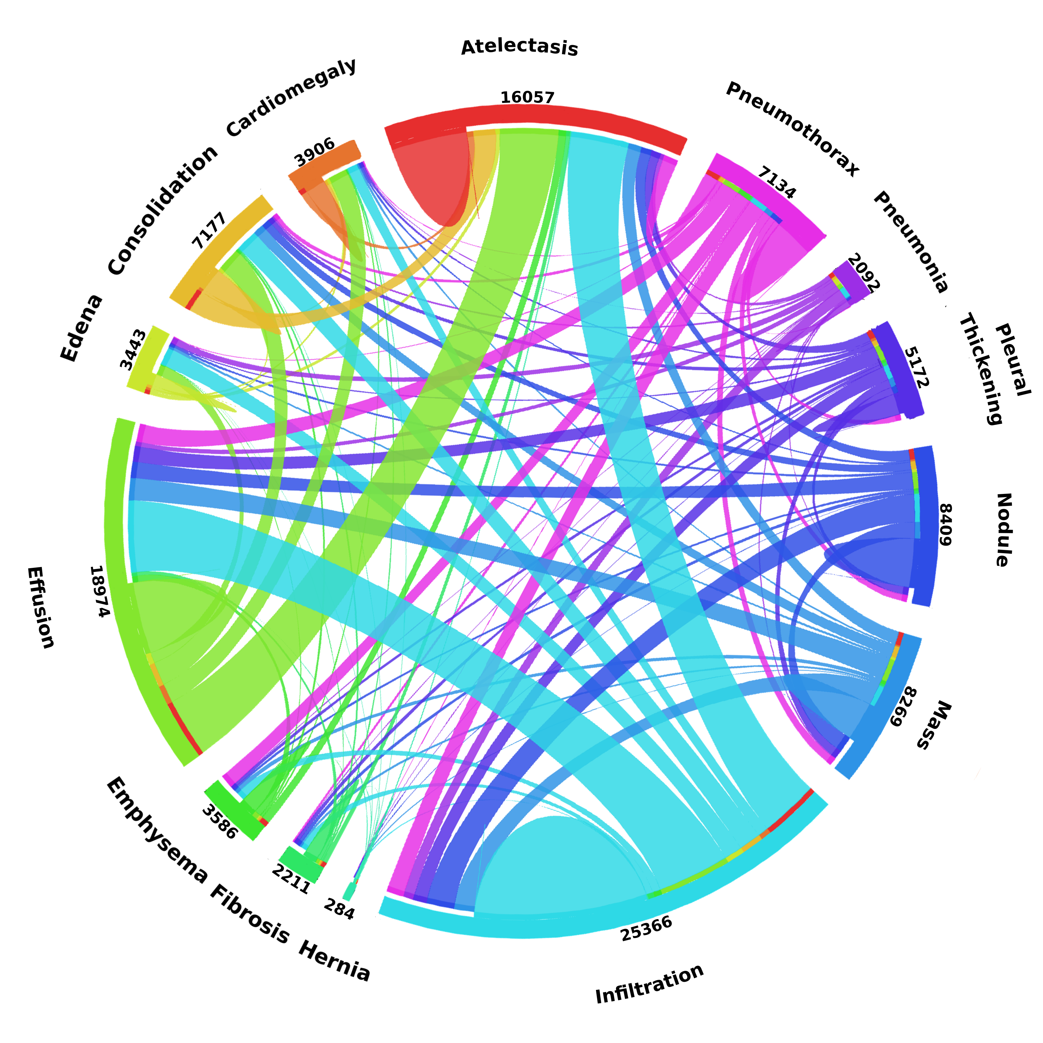
Pertinent Challenges
Data scape
  Co-morbidity of thoracic diseases
    Multi-class multi-hot classification
    Diseases
      Cardiomegaly
      Emphysema
      Edema,
      Etc. upto 14 classes
    Highly imbalanced
Image sizes
  1,024 x 1,024 x 1 – 8 bit
  ChestXRay14: 112,120 images from 30,000 unique patients
Controversies
  NLP strippers on Rx used to create dataset
  Missing and weak labels reports surfacing up in community

Slide 5
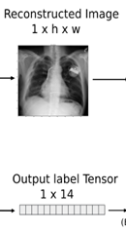

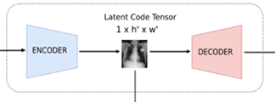
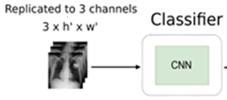
Training
Autoencoder
L₂
(MSE Loss)
{
L
(λL₁ + (1-λ)L₂)
Resized to 1xh’x’w’
L₁
BCE Loss)

Slide 6

Effect of $λ$

Slide 7
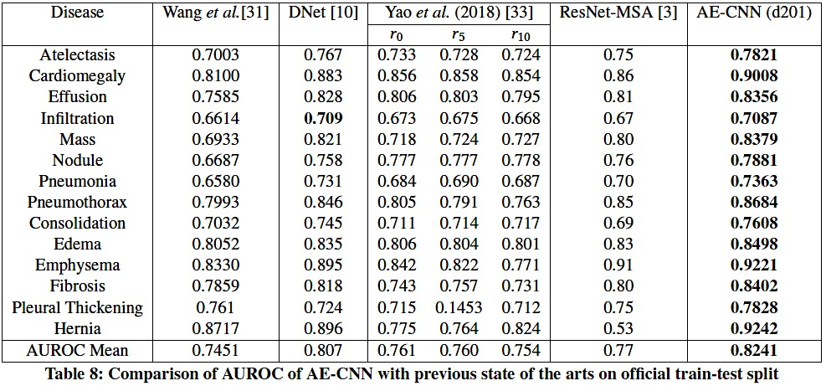
Performance Comparison

Slide 8
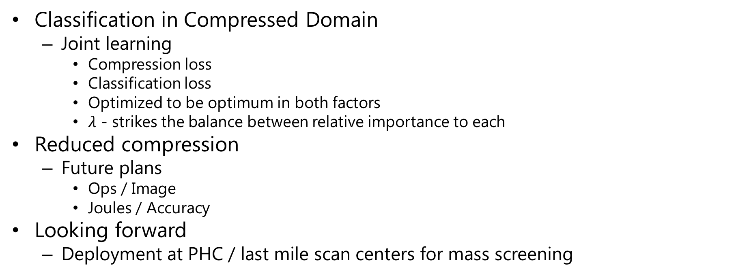
Take Home Message
Classification in Compressed Domain
  Joint learning
    Compression loss
    Classification loss
    Optimized to be optimum in both factors
    $λ$ - strikes the balance between relative importance to each
Reduced compression
  Future plans
    Ops / Image
    Joules / Accuracy
Looking forward
  Deployment at PHC / last mile scan centers for mass screening

